Slide 1


Costco Inventory
Forecasting
Business-led Technology Partners Delivering Real Digital Outcomes

Slide 2
Agenda
1
Problem Statement
2
Executive Summary
3
Results

Slide 3
Problem Statement for POC
Background
Costco Wholesale Corporation operates an international chain of membership warehouses, mainly under the "Costco Wholesale" name, that carry quality, brand-name merchandise at substantially lower prices than are typically found at conventional wholesale or retail sources.
As of 2022, Costco is the fifth largest retailer in the world and is the world's largest retailer of choice and prime beef, organic foods, rotisserie chicken, and wine as of 2016. Costco is ranked #11 on the Fortune 500 rankings by total revenue $227 billion.
Problem Statement
The current task at hand is to improve the Costco Inventory forecasts on various levels.
To improve the Costco shipment forecasts.
Forecast Costco SKUs on different levels at product & inventory level.​
In scope data
Sales Shipment Data responding to 3 years of time series data
Inventory data to week granularity
Forecasting demand to increase their revenue and to continue uninterrupted distribution,

Slide 4

Executive Summary
EDA
SARIMA & Analysis
Results
Analysis of performance of the curve of SARIMA,
LSTM, Prophet
Exploratory analysis
Trend analysis
Identified boundaries & Product’s patterns
Finalise the results & Modelling strategy
Acceptance critera & POC closure
BRD & Implementation (SDLC)

Slide 5
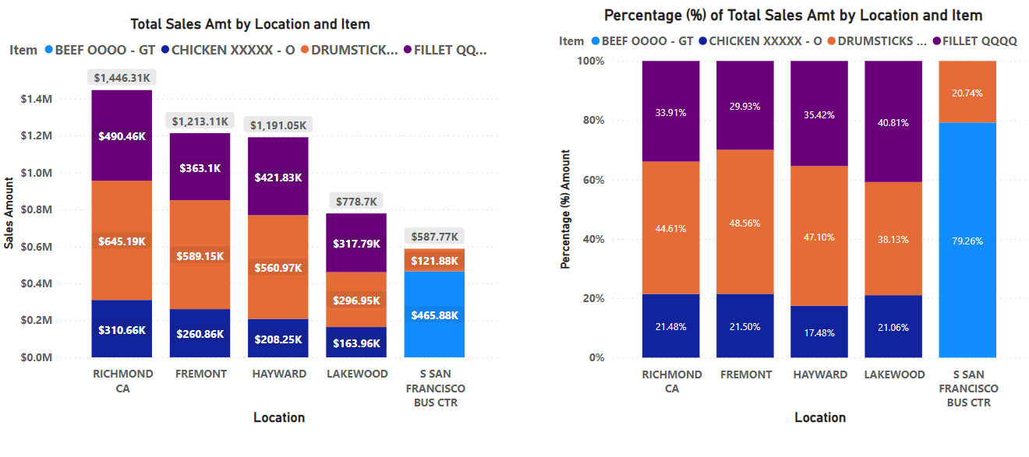
Sales Overview:

Slide 6
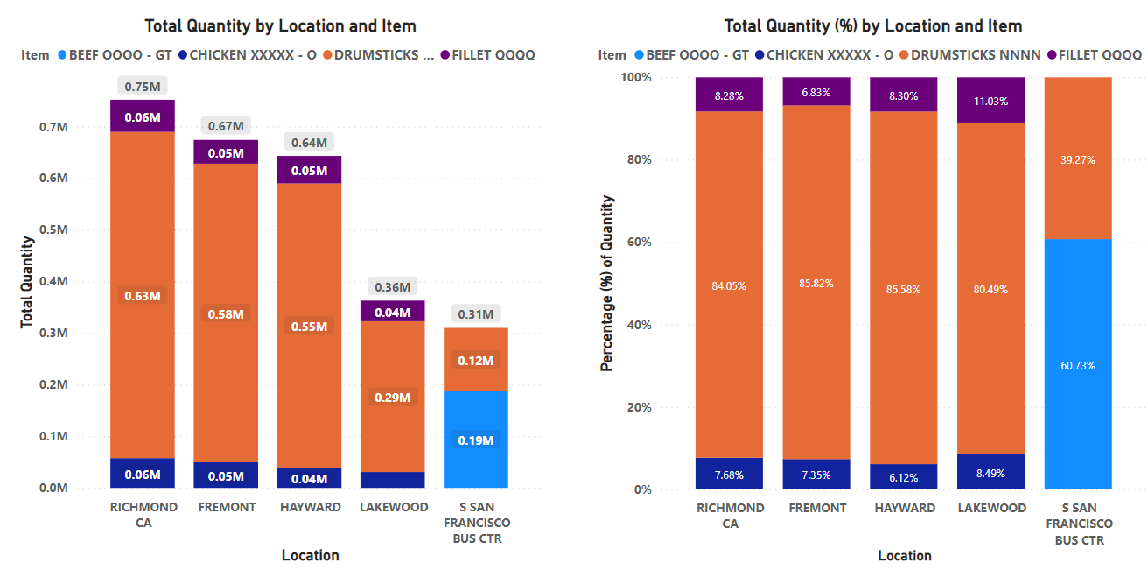
Quantity Overview:

Slide 7
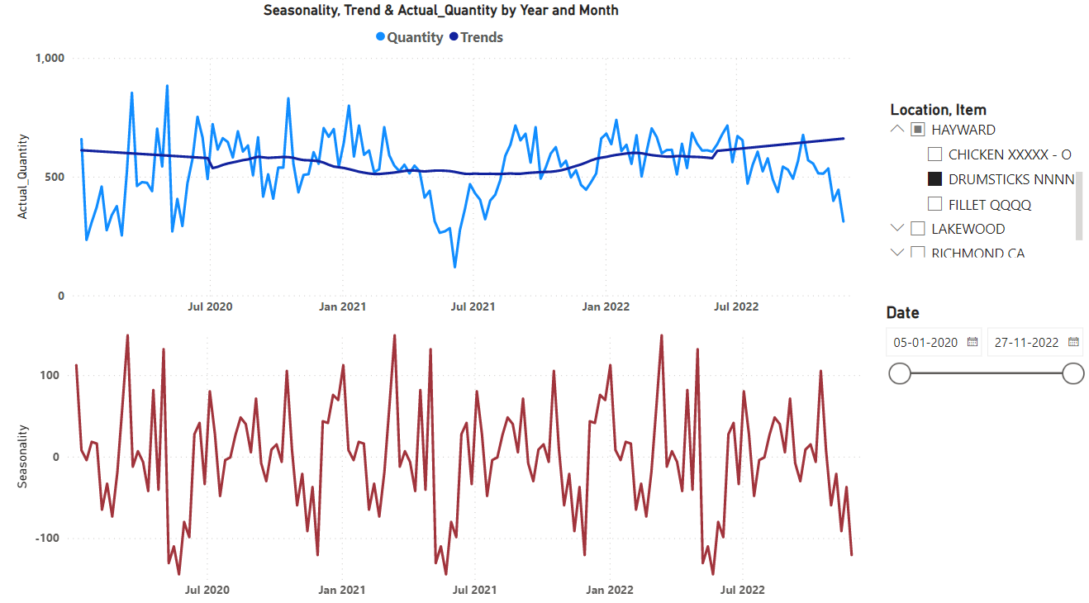
Trends and Seasonality:
Location: Hayward, Item: Drumstick

Slide 8
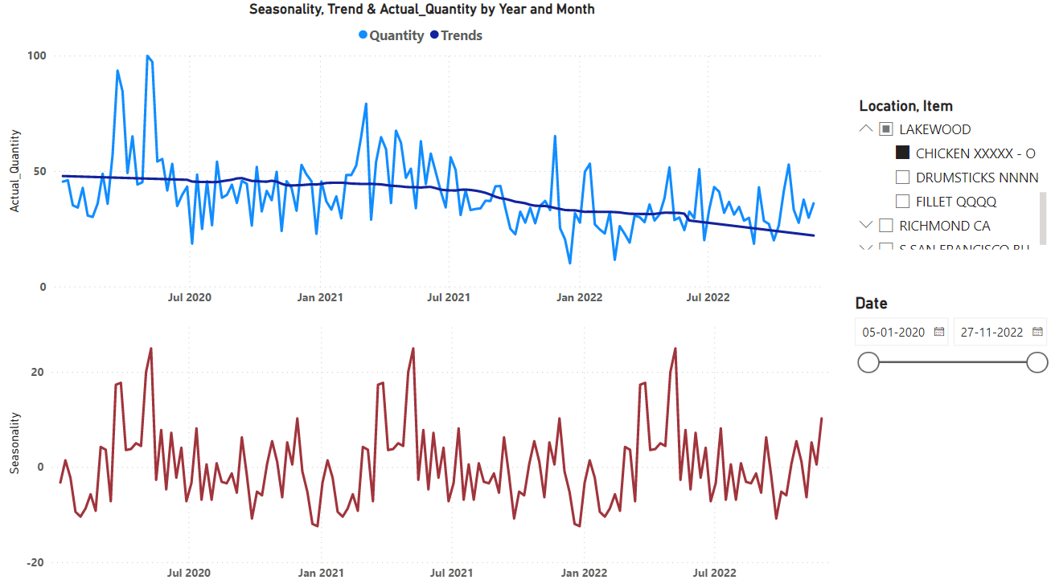
Trends and Seasonality:
Location: Lakewood, Item: Chicken

Slide 9
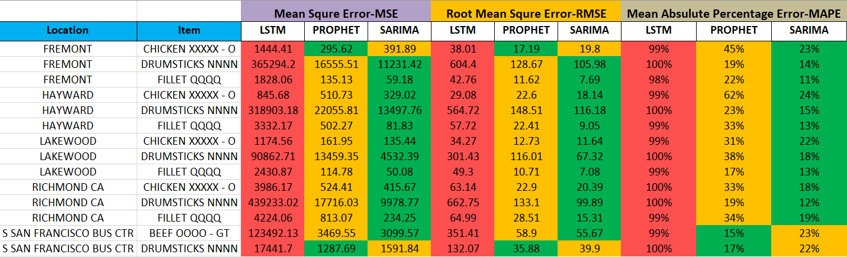
Forecasting Matrices:

Slide 10
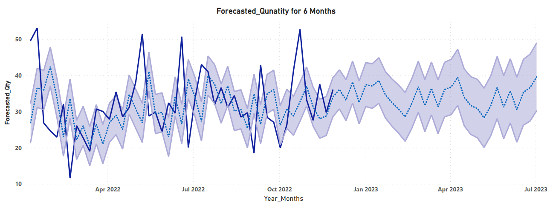
Forecasting:
Location: Lakewood, Item: Chicken
Blue Line: Actual_Qty
Dotted Line: Forecasted_Qty
MSE:135.44, RMSE: 11.64, MAPE: 22%

Slide 11
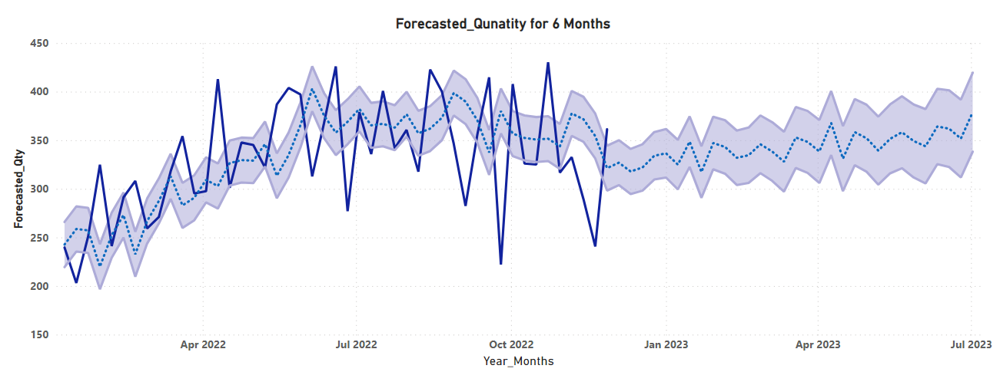
Forecasting:
Location: SAN FRANCISCO, Item: Beef
Blue Line: Actual_Qty
Dotted Line: Forecasted_Qty
MSE:3099.57, RMSE: 55.67, MAPE: 23%

Slide 12
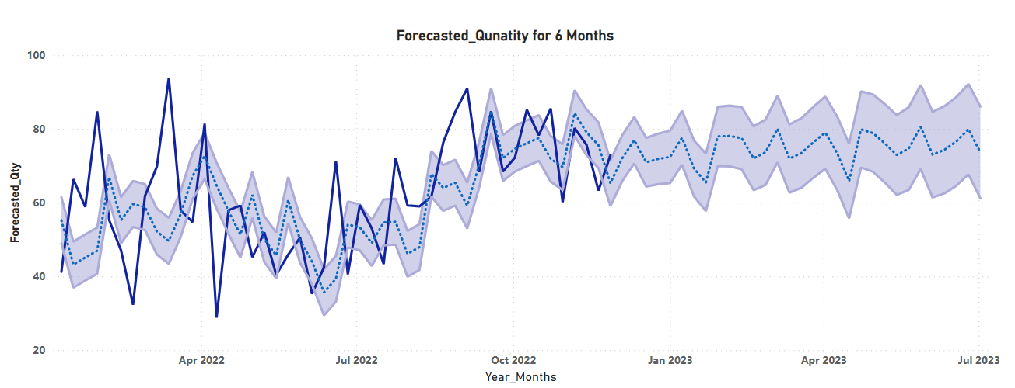
Forecasting:
Location: Richmond CA, Item: Fillet
Blue Line: Actual_Qty
Dotted Line: Forecasted_Qty
MSE:234.25, RMSE: 15.31, MAPE: 19%

Slide 13
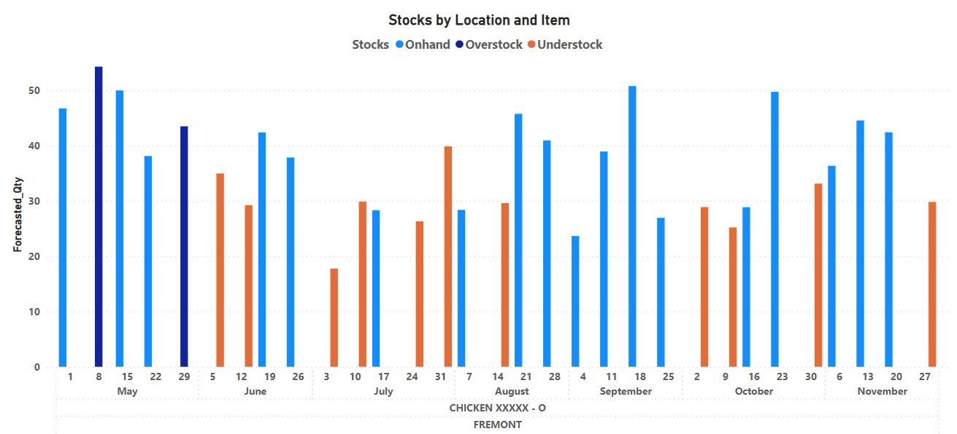
Weekly Onhand, Overstock and Understock cases: (May-Nov 2022)

Slide 14
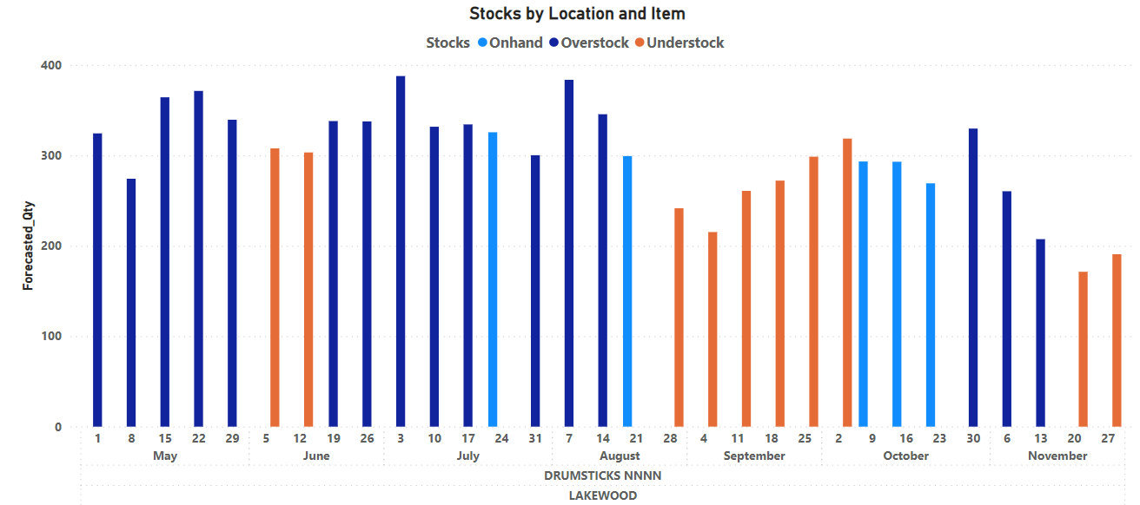
Weekly Onhand, Overstock and Understock cases: (May-Nov 2022)

Slide 15
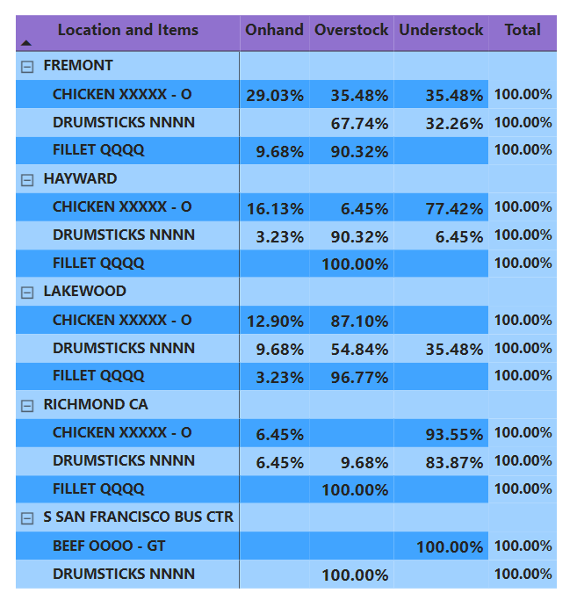
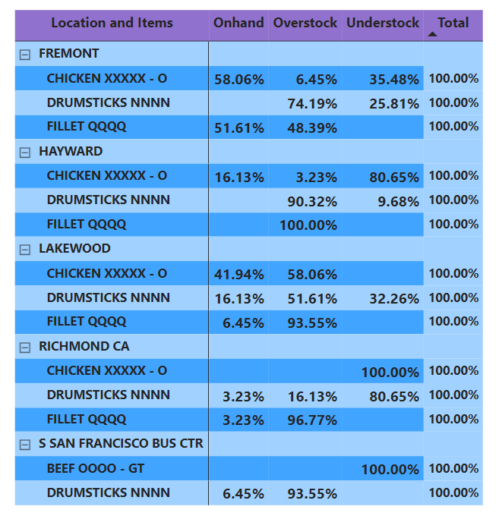
Stock Analysis (May-Nov 2022):
Actual Data
Forecasted Data

Slide 16
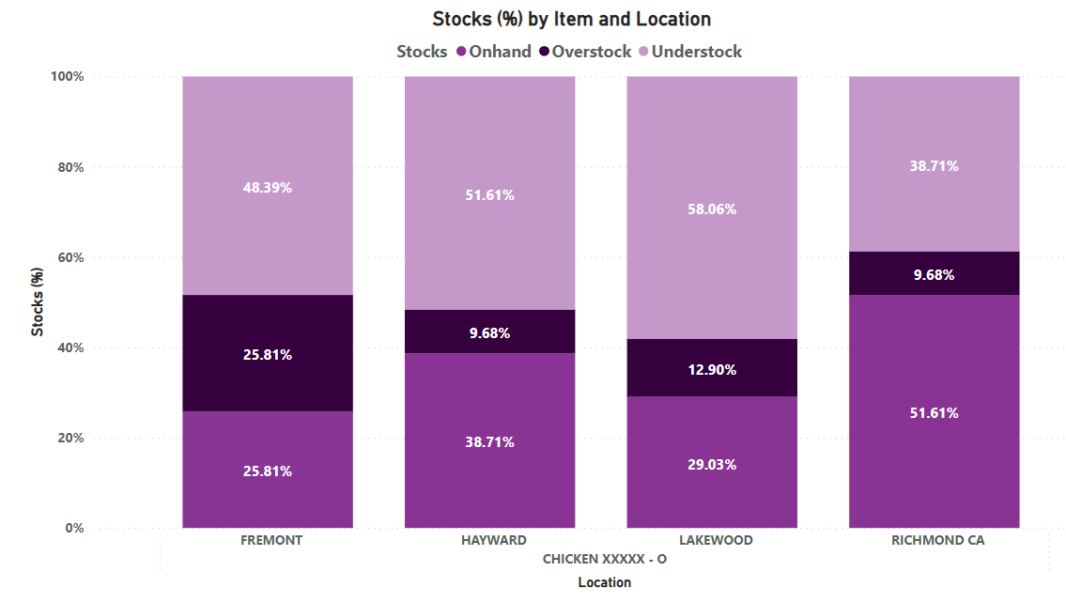
Stocks by item & location

Slide 17
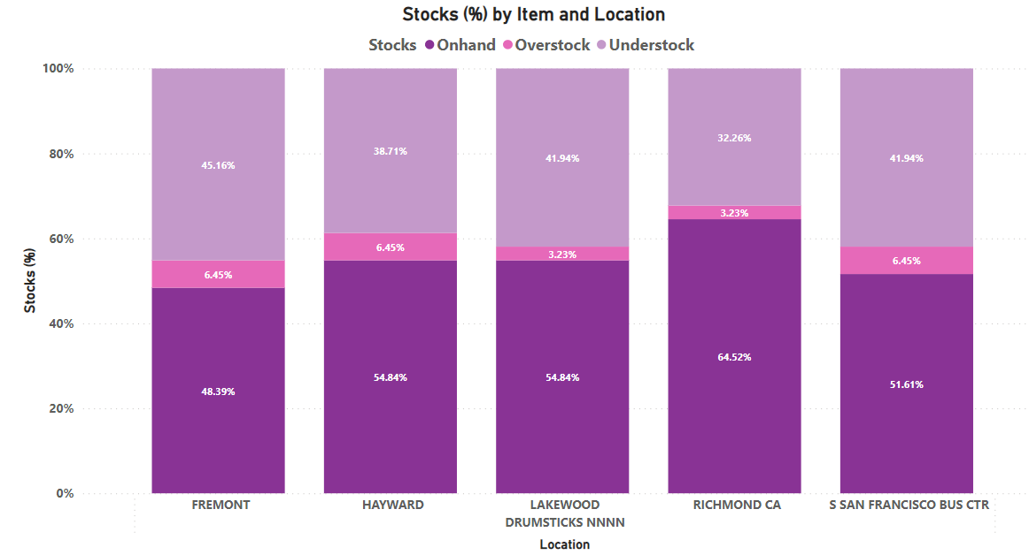
Stocks by item & location

Slide 18

Appendix

Slide 19
Our Power BI Credentials
One of the leading Power BI Partner globally
Trained 4,000+ users globally through 100+ events
Implemented Power BI Premium at several large enterprises
Key focus on 3 A’s: Adoption, Agility & Actionable
Helped create data culture at several organizations
A strong team of Power BI evangelists & consultants with proven expertise

Slide 20



About iLink
iLink Systems delivers next-generation technology solutions to help clients solve complex business challenges, increase business productivity, realize sustainable enterprise value and transform their businesses inside-out
Company Overview
Locations
Focus Area
Founded in 2002
Global Software Solution Provider
Trusted Digital Advisor
Innovation Focused
ISO 9001 & CMMI Level 3 Certified
Gold Certified Microsoft Partner
Nationally Managed Microsoft Partner
Won 4 Partner of the Year Awards
~700 people global team
Seattle, WA (HQ)
Los Angeles & Irvine, CA
Fairfax, VA
Atlanta, GA
Dallas & Houston, TX
Chicago, IL
New Jersey, NJ
Chennai, Pune & Trichy, India
Dubai
Product Development
App Modernization
Cloud Platform
Data Platform
Business Analytics
Artificial Intelligence
Internet of Things (IoT)
QA Automation
DevOps
Telecom
Healthcare
Life Sciences
ISV
Oil & Gas
Chemical
Financial Services
Retail
Manufacturing
Consumer Goods
Business-led Technology Partners Delivering Real Digital Outcomes

Slide 21






























Our Customer Portfolio

Slide 22
Why iLink?
Helped create data culture at several organizations
Implemented Cloud Data Warehouses & Data Lakes in several large enterprises
Implemented Modern Cloud BI in several large enterprises
Big enough to deliver & small enough to care
A strong team of data & analytics consultants with proven expertise
Very flexible engagement models that fits best for our customer needs

Slide 23
Thank You

